Slide 1



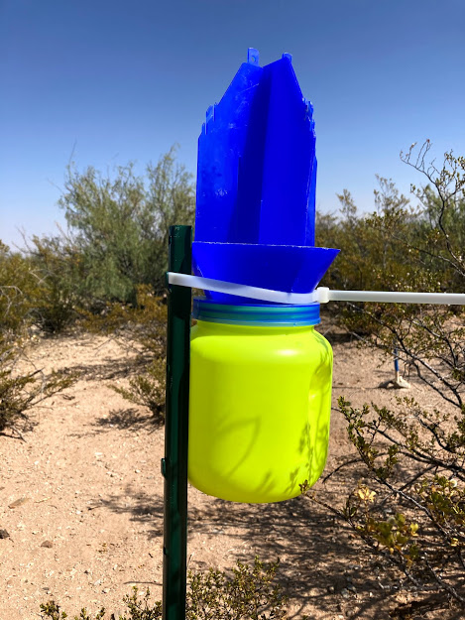
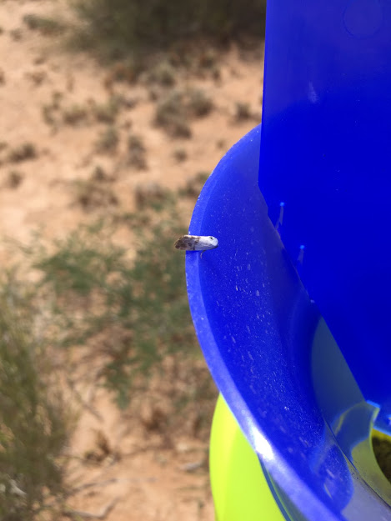
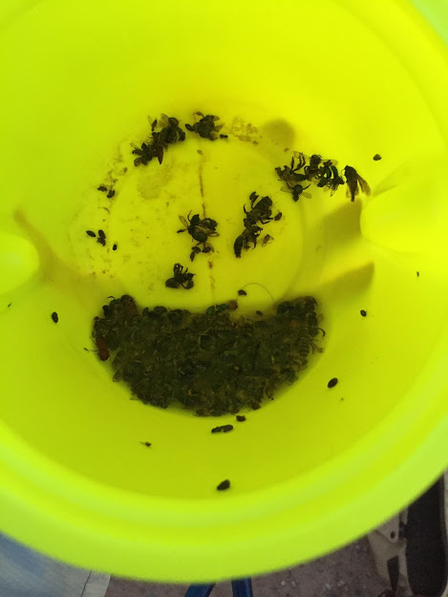
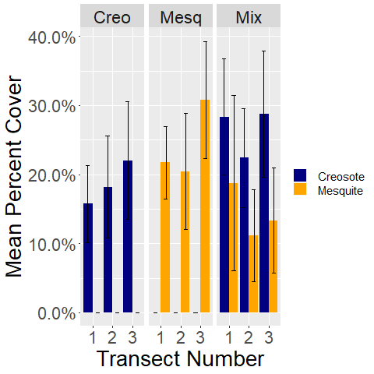
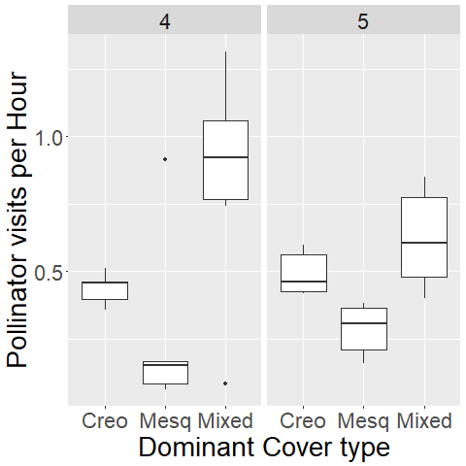
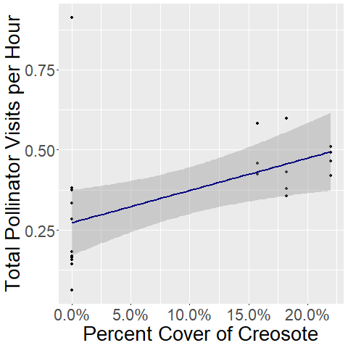
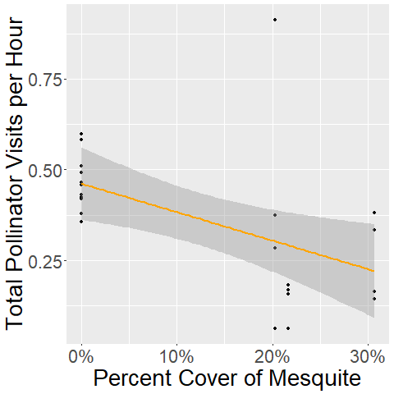

Pollinators in the Chihuahuan Desert: Broadening Our Understanding
Matthew Tryc¹ and Scott Ferrenberg¹
¹Department of Biology New Mexico State University
Introduction Methods & Objectives
Pollinators are a diverse guild of organisms that assist in moving pollen from one plant to another and aiding in the plant's reproduction.
Pollinators interact with their habitats in different ways and are influenced by their surroundings in different ways.
Pollinators are under threat from human activities such as land use changes, pesticide use, and climate change.
Combined with the lack of information of the pollinators of this region, this creates a precarious situation for conservation.
This project aims increase knowledge of pollinators by determining the species of this area as well as what habitat variables they interact with.
Pollinator Trapping
Three types of sites, classified based on dominant cover type: Creosote, Mesquite, or Co-dominant stands (three each)
Collecting data on shrub density and flowers within each transect
HOBO Temperature Sensors were placed within each plot
Two blue vane traps (BVT’s)(Fig. 2) were placed on either end of the transects
Sample Processing
Samples from the BVT’s were put in alcohol and sorted in the lab
The sorted pollinators were pinned and labeled with numbers corresponding to a database
Specimens were identified to order for this project, but will be identified to further levels in the future
Fig. 2: Blue van traps in situ showing collected insects
Preliminary Results
Cover of Mesquite and Creosote
Number of Pollinators per Trap
Effect of Creosote Cover
Effect of Mesquite Cover
There are significant differences between the cover of Creosote and Mesquite within the sites (as designed, p = 0.0284) (Fig. 3A). There is a significance difference in the number of pollinators per hour in the traps between the sites (PERMANOVA p < 2 x 10¹⁶ ), however, there are not significant differences (p=0.5714)between sample periods 4 and 5 (Fig. 3B). The effect of creosote appears to be positively correlated (m= 1.006) with the number of visits per hour (Fig. 3C). The opposite seems to be true for mesquite, a negative correlation with percent cover (m=-0.7843) (Fig. 3D). Sampling period notably did not influence this relationship. This appears to explain the pattern within the different number of visits for the mixed sites as they had slightly more cover of creosote than the designated creosote sites.
A B C D
C
y = 1.006x+0.0364
Adjusted R² = 0.218
p-value = 0.01243
y=-0.7843x+0.3670
Adjusted R²= 0.2334
p-value = 0.009766
C
A
A
B
B
Conclusions References & Acknowledgements
There seems to be some association between the cover of Creosote and Honey Mesquite and the number of pollinators visiting the sites. However, this is only preliminary as there are four more sampling periods (three before and one after) these two sampling periods. The differences between these periods may be enough to disrupt these patterns and could reveal a stronger relationship with time. Going forward, there is a tremendous amount of data that remains to be analyzed with regards to temperature, temporal (day length, average day temperatures, average night temperatures, etc), and flowering data. Additionally, there is more to be done with identifying the pinned insects and modeling their diversity and individual statistics.
Thanks to Steven Lee and Megan Rabinowich for helping me get to my field sites and Milda Kristupatis for the idea of using blue vane traps
References
Burdine, J.D., McCluney, K.E. Sci Rep 9, 1643 (2019).
Hall, M.A., Reboud E.L. Austral Entomology, 4 58 (2019)
Hall, M. A.. Agricultural And Forest Entomology 4, 20 (2018)
Notes:
Single sided poster!

Slide 2
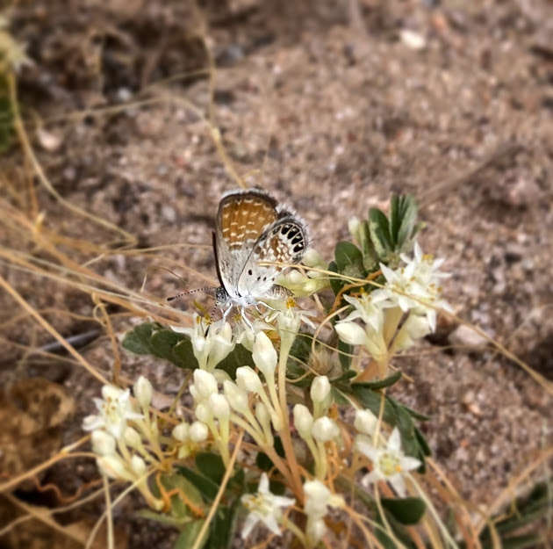
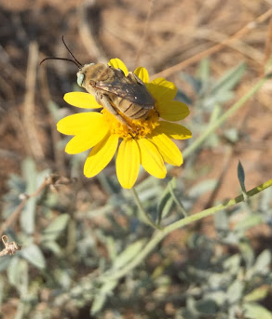
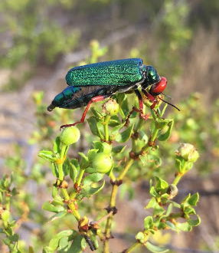
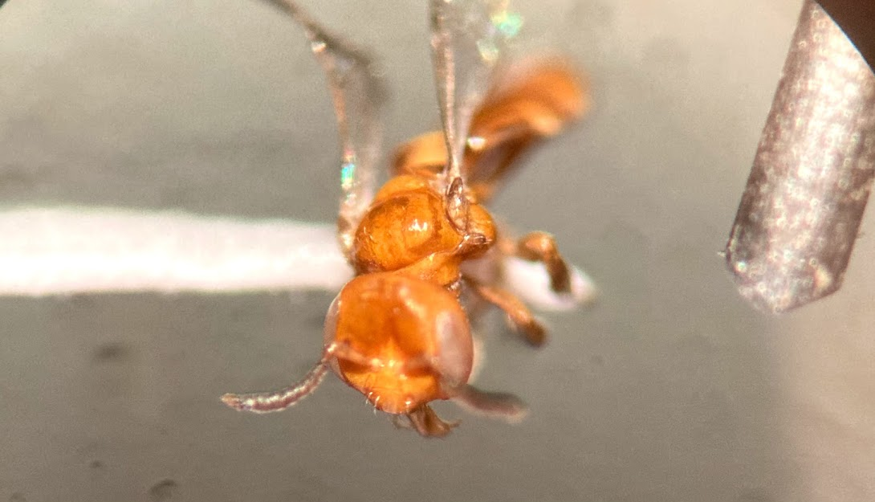
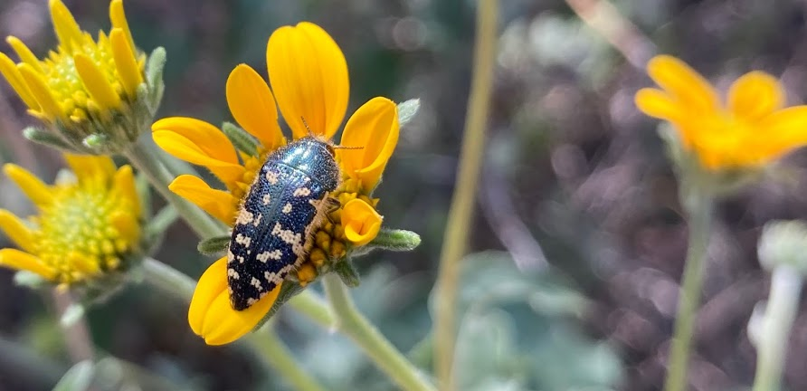
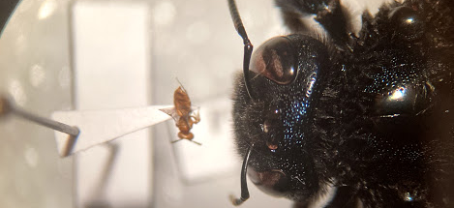
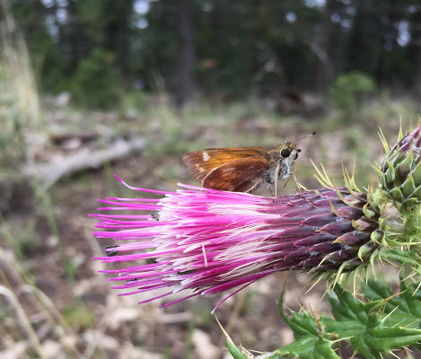
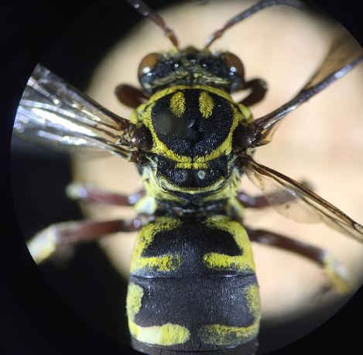
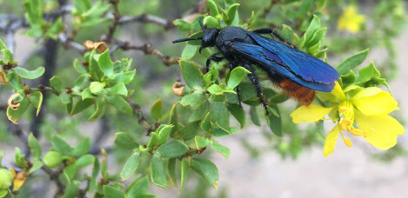
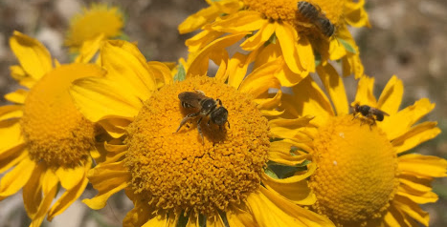
Pollinators are very diverse!!!!
If you like these photos of pollinators and want to see more interesting photos, follow me on Instagram for more @matthewtryc

Slide 3
Blue Vane Traps in the Field
Fig. 2: Blue vane traps. (Left) Blue Vane Trap in field site. (Center) Close up of a BVT with a yucca moth on the rim (in red). (Right) Traps filled with bees, flies, and other pollinators in water.

Slide 4
Preliminary Results
Cover of Mesquite and Creosote
Number of Pollinators per Trap
Effect of Creosote Cover
Effect of Mesquite Cover
A B C D
C
y = 1.006x+0.0364
Adjusted R² = 0.218
p-value = 0.01243
y=-0.7843x+0.3670
Adjusted R²= 0.2334
p-value = 0.009766
C
A
A
B
B
Fig. 4A: Percent cover of Creosote and Mesquite per transect (error bars represent standard error. B: The average number of pollinators in the traps, scaled for the number of hours in the traps were in the field. C: The effect of Creosote cover on the scaled number of bees in the traps per dominant cover type over two sampling periods (late August/early September [4] and late September [5]). D: The effect of Mesquite cover on the scaled number of bees in the traps per dominant cover type over two sampling periods (late August/early September [4] and late September [5]).

